Slide 1
Advanced Graphics – Physically Based Rendering
Jainesh Pathak
June 2023
School of Computing Science
Newcastle University
J.P.Pathak2@newcastle.ac.uk

Slide 2
Background
Lighting plays an important role to bring realism in computer graphics.
2.5D games like Doom introduced “Sector-based” lighting and “Light Diminishing”:
Sector-Based Lighting:
Every sector had a light level with range 0-255. 0 being complete dark and 255 being very bright.
Light Attenuation were done where light levels of neighbour sectors gradually decreases to show light is traveling over distance.
Light Diminishing:
Sector area from player’s point of view is bright enough for player to see and slowly decreases as the distance between area and player increases. Also used in simulating fog.
As GPUs progressed, lighting and overall video game graphics also progressed.
3D Games like Unreal, Doom 3 showcased more dynamic lighting with different light sources: Point, Directional, Spot Lights.
Blinn-Phong light model became widely popular and used in computer graphics.
Uses sum of three components: Ambient, Diffuse and Specular.
Blinn-Phong shading disadvantages:
Violates conservation of energy law. Energy is lost as specular intensity is increased.
Doesn’t take the metallic and roughness surface properties on a microfacet level in account.

Slide 3
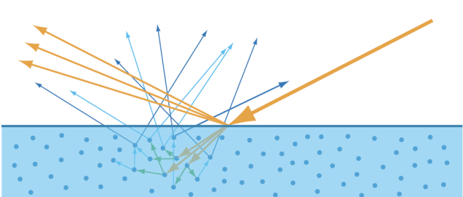
Introduction
Light Terminologies: Diffuse (Refraction) and Specular (Reflection)
Physically-based Rendering (PBR):
Lighting equations in real-life are too complex and computationally expensive.
PBR is collection of techniques to bring light interactions in the real world physics approximation.
To do physical approximations, it needs to follow three rules:
Based on microfacet surface model.
Energy conserving – outgoing light reflected should not exceed incoming light.
Uses a physically based BRDF.
Bidirectional reflective distribution function (BRDF):
Function that describes the reflectance properties of a the surface on a microfacet level.
Takes the incoming light L, view direction V, surface normal N and surface roughness A as inputs.
It approximates how much light ray gets reflected based on the surface properties.
The most famous is the Cook-Torrance BRDF:
Fr = Kd * fLambert + Ks * fCook-Torrance.
fLambert is the diffusion part.
fCook-Torrance is the specular part.

Slide 4

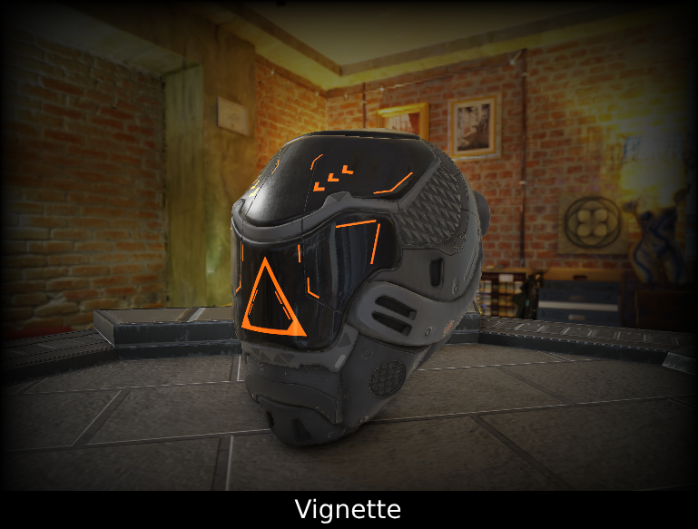
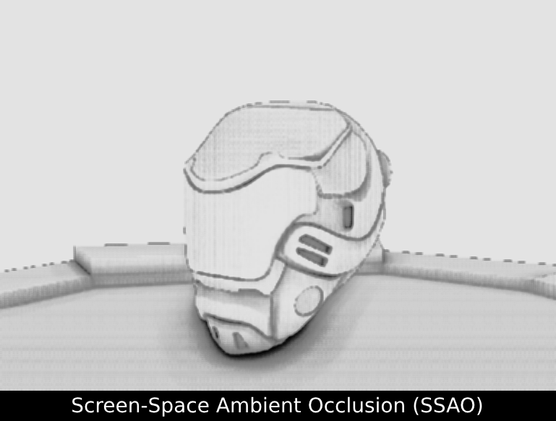
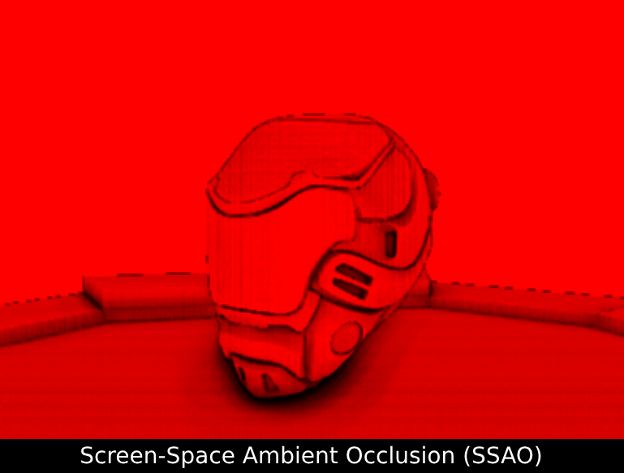
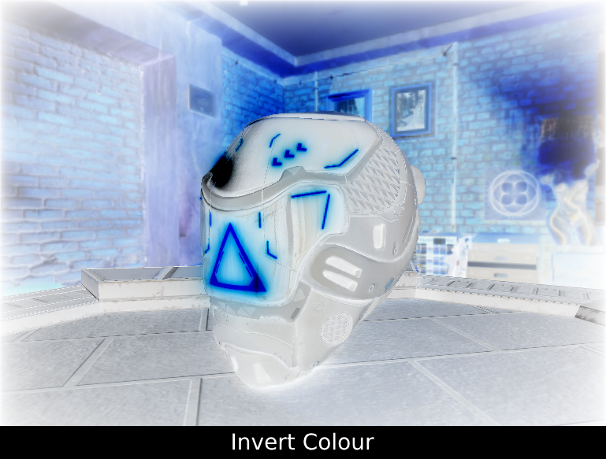
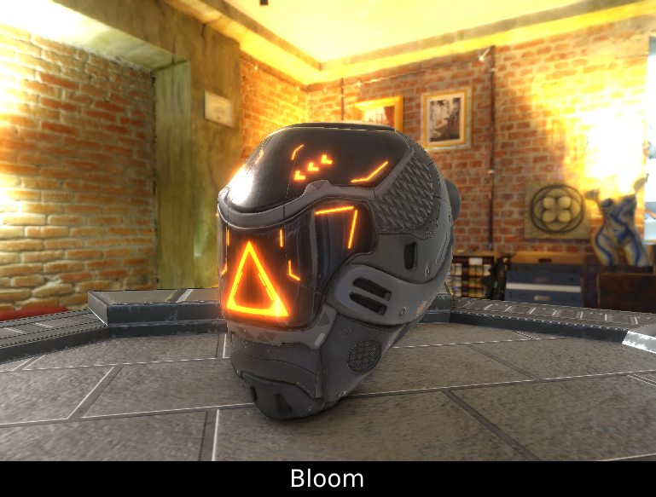
Implementations
Using OpenGL and NCLGL framework as a base.
Dear ImGui framework for debugging, tweaking parameters at runtime and profiling.
Different types of BRDFs are made for comparison:
PBR Cook-Torrance
PBR Disney
Blinn-Phong
Oren-Nayar + Beckmann/GGX/Gaussian
Post Processing Effects:
Bloom
Vignette
SSAO
Invert Colour
Gamma Correction and Tone Mapping:
Reinhard Tone Mapping
Shadows:
Basic Shadow using PCF filtering with directional light as a light source.

Slide 5
Implementations
Image-based Lighting (IBL):
Using HDR textures to convert to Cubemaps.
Exposure controllable from ImGui
Five different types of skybox used to show ambient lighting on surfaces
Diffuse Irradiance
Specular Prefiltering and Lookup table
For PBR, different textures are being used:
Albedo: Base colour
Normal: Surface details
Metallic: Metallic or Dielectric
Roughness: Controls the smoothness
Emission: Emitting light from surface
Ambient Occlusion: Enhances shading
Lights:
Billboard effect to show different types of light sources.
Material System:
Basic material system which applies to whole mesh instead of sub-meshes.

Slide 6
Challenges
Lights Performance:
Sending light attributes to every frame is heavy on performance.
To counter this, Uniform Buffer Objects (UBO) are used.
OpenGL version 4.20 is used for easy setting the binding points of UBOs
Light attributes are stored in a struct and datatype of Vector4 are used for memory alignment and padding precisions.
Lights UBO Data are not sent every frame. Instead, they are sent when there is a change in any of the light attributes when using ImGui.
Uniform Buffer Objects:
Also used to store the view projection matrix.
Skybox light data like Gamma and Exposure intensity.
Texture Loading Time:
PBR Textures are quite heavy to load due to size of resolutions.
Loading the textures in main thread is not effective.
To solve this, Multi-threading is used.
The texture’s raw data are loaded using threads and once loaded the usual OpenGL texture objects are created loaded with raw data.
This reduced the loading time from 17 seconds to 7-8 seconds.

Slide 7
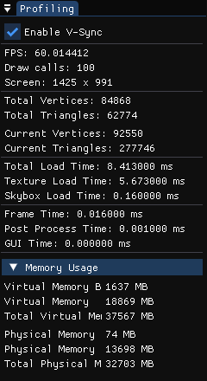
Analysis and Evaluation
Profiling:
Dear ImGui framework is used to profiling at runtime.
Frames Per Second (FPS) stayed at a stable 60 FPS with V-Sync on and approximately 350 FPS when V-Sync is off.
Draw calls count are shown.
Total vertices and triangles shows the total vertices and triangles of all meshes loaded.
Current vertices and triangles shows the stats of meshes drawn in current screen.
Total load time is time taken to load the whole program start to first frame.
Texture load time is time taken to load the textures. Using threads significantly reduced the load time.
Skybox time denotes the duration of capturing and processing all five skyboxes.
Frame time is the time between current frame and previous frame.
GUI time is time for rendering of all ImGui windows.
Memory Usage:
Both virtual and physical memory usage is shown.

Slide 8
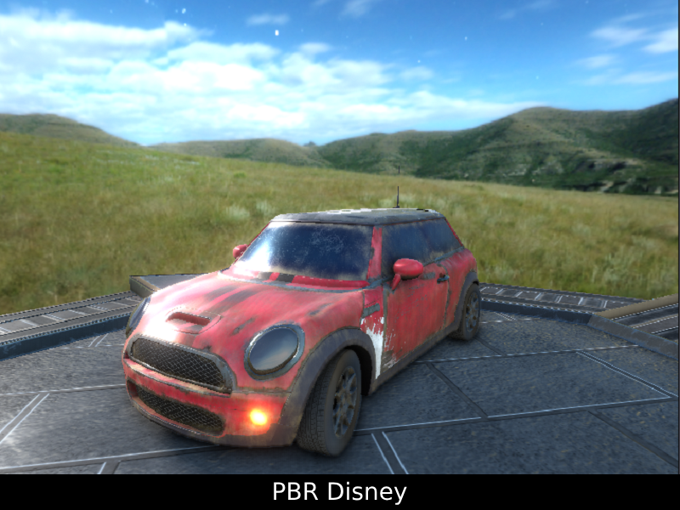
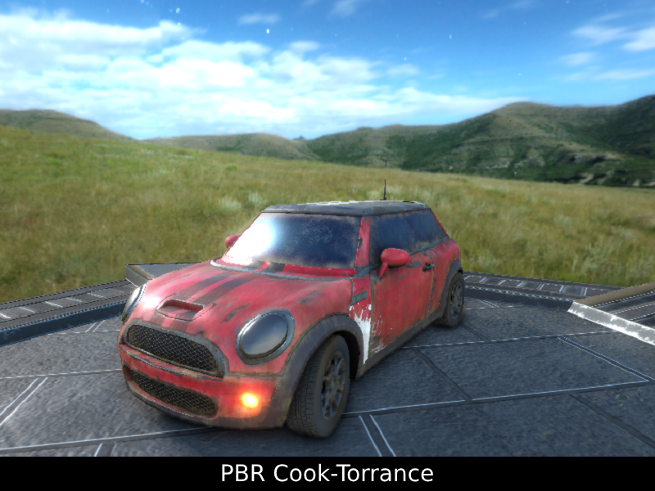
Analysis and Evaluation
Disney PBR vs PBR:
Visually not much of difference.
Disney diffuse uses Burley BRDF.
Burley BRDF is a mix of dielectric and metallic BRDF based on metallic parameter.
Disney provides more parameters like Sheen, Anisotropic Specular, Clearcoat.
Anisotropic filtering used the Ward BRDF to simulate specular like on brushed off metals.
Disney uses GTR for Normal Distribution.
Additional parameters requires more computations.
PBR uses Lambert diffuse.
PBR uses Schlick-GGX for Normal Distribution.
Has less control over Specular part.
Both use the same Fresnel-Schlick for Fresnel effect.
PBR is generally more light-weight when compared to Disney BRDF and is widely used in video games.

Slide 9
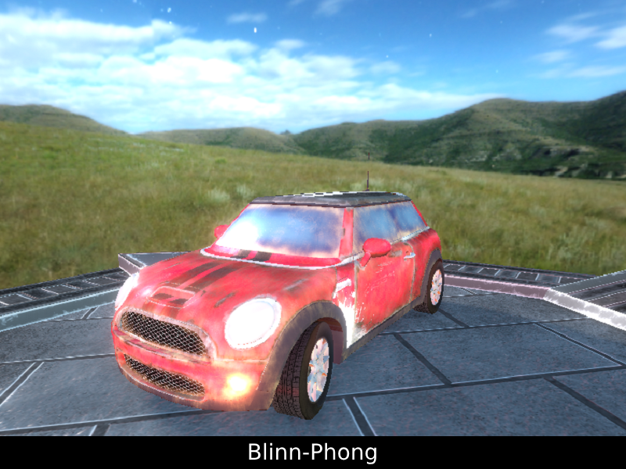
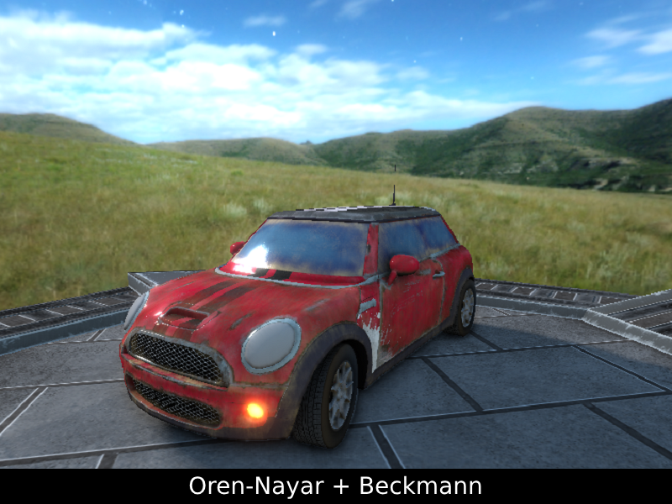
Analysis and Evaluation
Blinn-Phong vs Oren-Nayar:
Blinn-Phong ignores energy conservation law which results in bright colours.
Blinn-Phong uses lambert diffuse.
Blinn-Phong also ignores the metallic and roughness properties of the surface.
Blinn-Phong is more suitable in terms of performance and simple graphics due to being light-weight.
Oren-Nayar is a diffuse BRDF for handling rough surfaces on microfacet level.
Oren-Nayar works well on surfaces with high roughness like brick wall, wood, etc.
Oren-Nayar can be merged with other specular model like Torrance-Sparrow Specular model.
Oren-Nayar BRDF is also merged with three additional specular effects i.e. Gaussian, GGX and Beckmann.

Slide 10
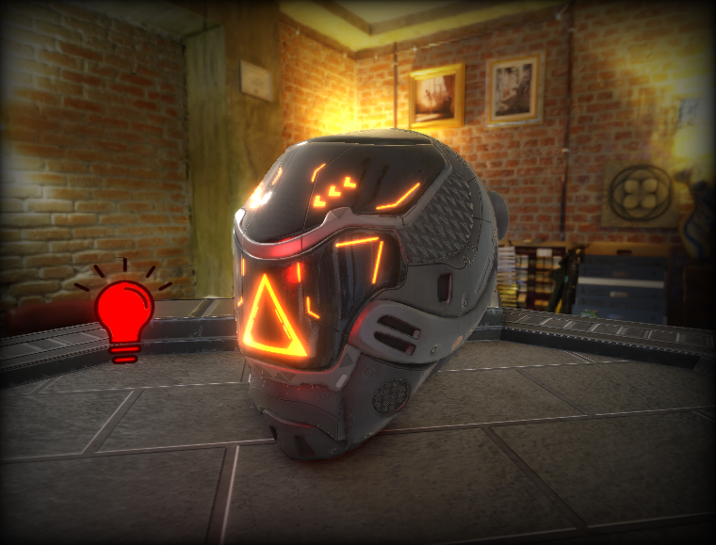
Conclusion
Real world lighting physics can be simulated in computer graphics with the help of Physically based rendering (PBR).
Use of PBR or Phong shading depends on the need of the application.
PBR, Phong, Oren-Nayar all have their pros and cons.
Phong is more suitable for performance and simple visuals.
Use for PBR went up as hardware progressed and demand of real life graphics is high.
Oren-Nayar is a diffuse BRDF and more widely used in animated movies than in video games.
Future work:
Implement Cascaded Shadow Maps.
Proper material system which applies to sub-meshes.
Transparent materials apply to sub-meshes and sorting them.
More post-processing effects.
Proper multi-threading to load assets using multiple OpenGL contexts.
Links:
Youtube: CSC8599 – Physically Based Rendering (PBR)
Github: CSC8599 - Github

